Slide 1

Sai Srikar Lab-4

Slide 2
PANTONE® COLOUR OF THE YEAR 2022
import cv2
import numpy as np
img1 = cv2.imread('wp3013104.jpeg')
img2 = cv2.imread('butterfly.jpeg')
N_img1=cv2.resize(img1,(500,500))
N_img2=cv2.resize(img2,(500,500))
cv2.imshow("Image-1",N_img1)
cv2.waitKey(0)
cv2.destroyAllWindows()
cv2.imshow("Image-2",N_img2)
cv2.waitKey(0)
cv2.destroyAllWindows()
img_and=cv2.bitwise_and(N_img1,N_img2)
cv2.imshow("Bitwise-AND",img_and)
cv2.waitKey(0)
cv2.destroyAllWindows()
img_or=cv2.bitwise_or(N_img1,N_img2)
cv2.imshow("Bitwise OR",img_or)
cv2.waitKey(0)
cv2.destroyAllWindows()
img_xor=cv2.bitwise_xor(N_img1,N_img2)
cv2.imshow("Bitwise Ex-0R",img_xor)
cv2.waitKey(0)
cv2.destroyAllWindows()

Slide 3
PANTONE® COLOUR OF THE YEAR 2022
img_not=cv2.bitwise_not(N_img1,N_img2)
cv2.imshow("Bitwise Not",img_not)
cv2.waitKey(0)
cv2.destroyAllWindows()
img_in1=cv2.imread('lab4/image1.png')
cv2.imshow("Image1",img_in1)
cv2.waitKey(0)
cv2.destroyAllWindows()
img_in2=cv2.imread('lab4/iamge2.png')
cv2.imshow("Image2",img_in2)
cv2.waitKey(0)
cv2.destroyAllWindows()
img_intersection=cv2.bitwise_and(img_in1,img_in2)
cv2.imshow("Intersection of Two Images",img_intersection)
cv2.waitKey(0)
cv2.destroyAllWindows()

Slide 4
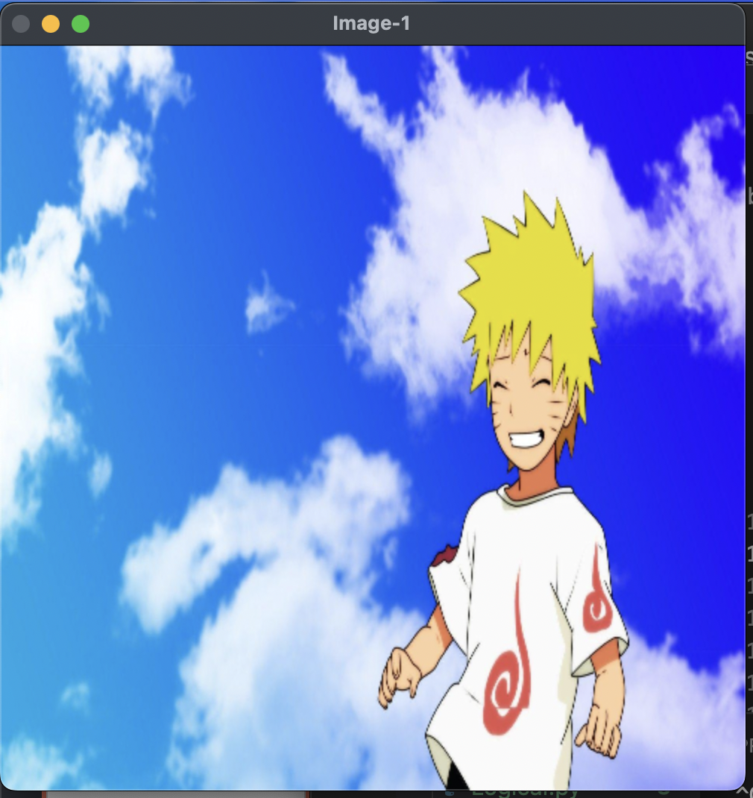
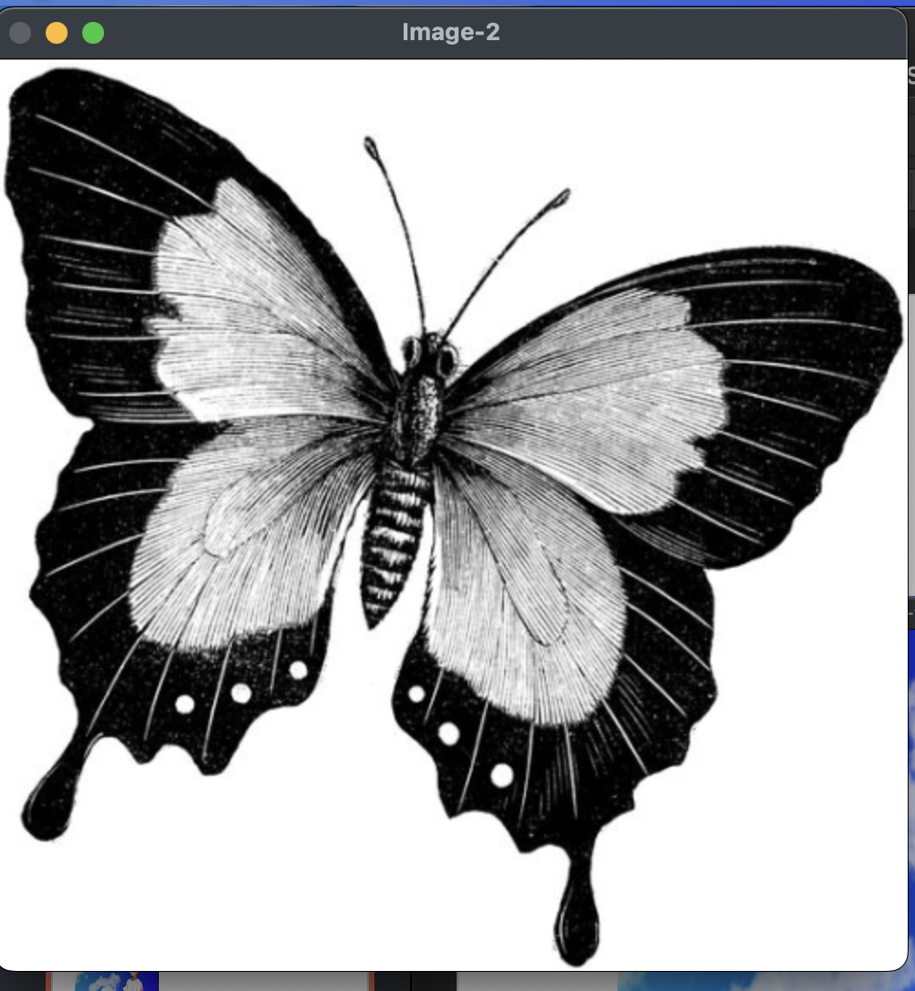
PANTONE® COLOUR OF THE YEAR 2022
OUTPUT-:

Slide 5
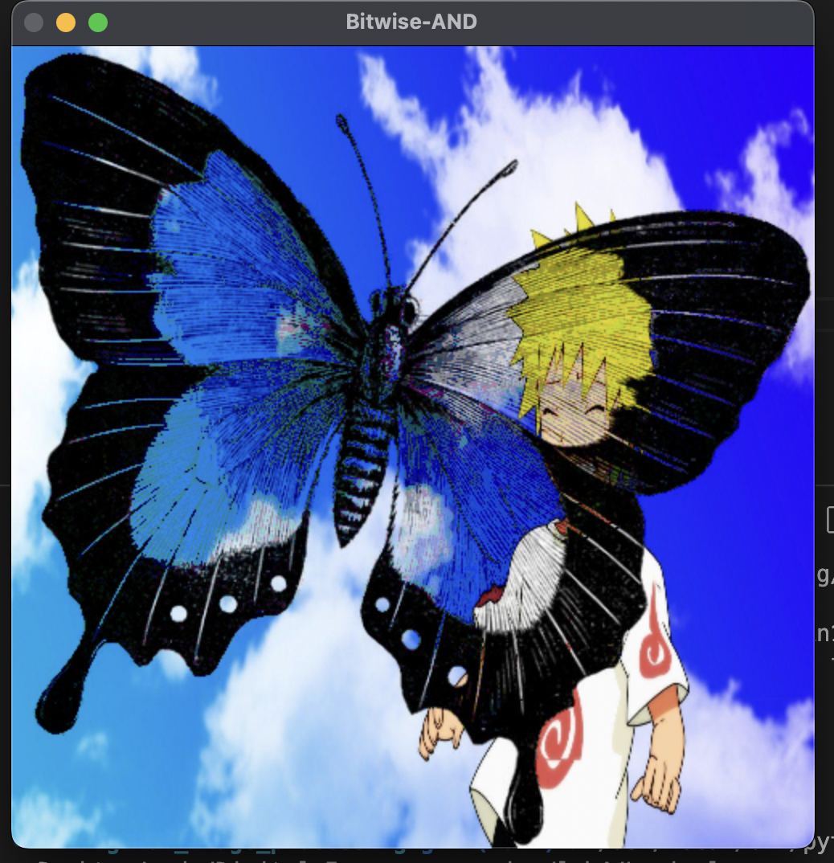
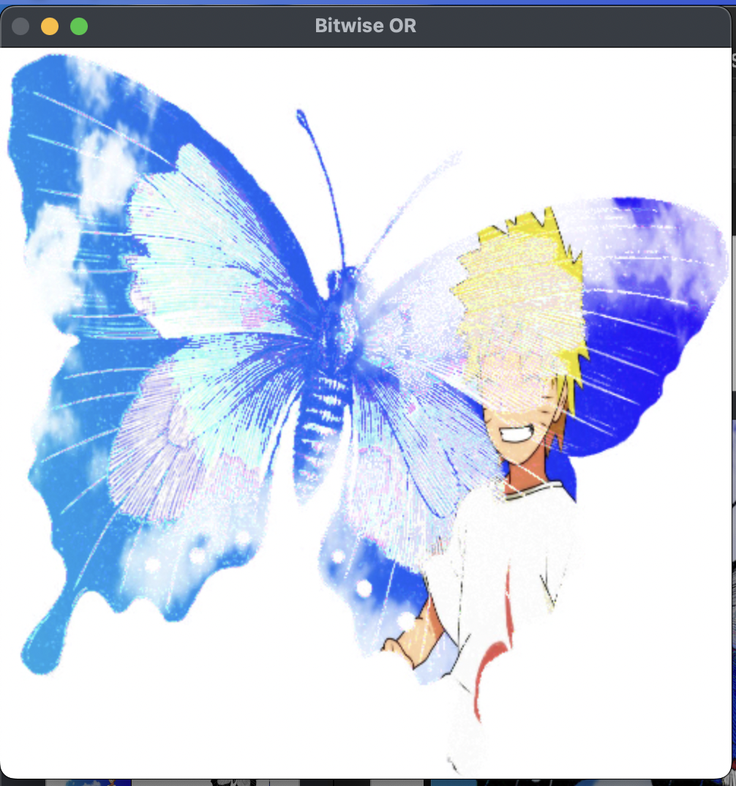
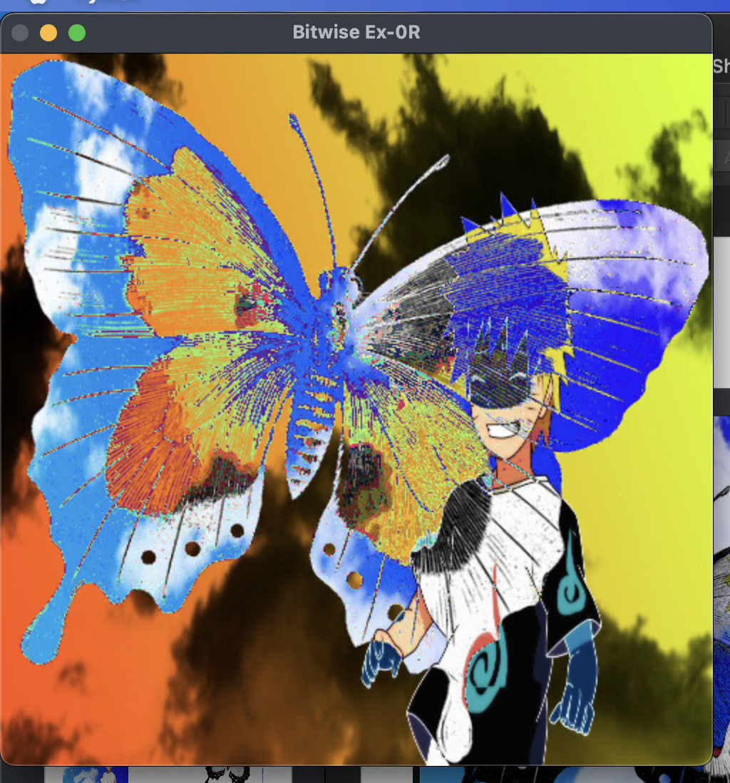
PANTONE® COLOUR OF THE YEAR 2022
OUTPUT-:

Slide 6
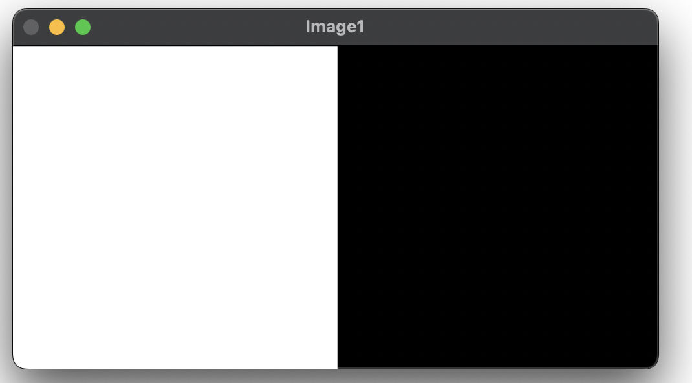
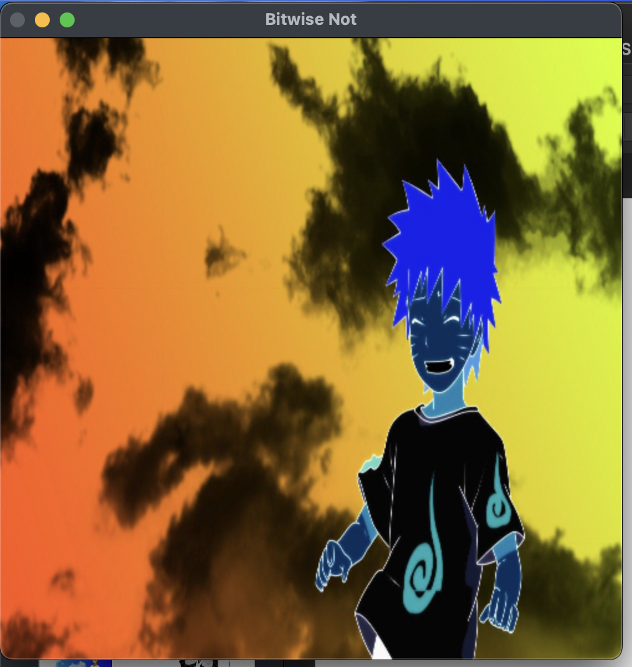
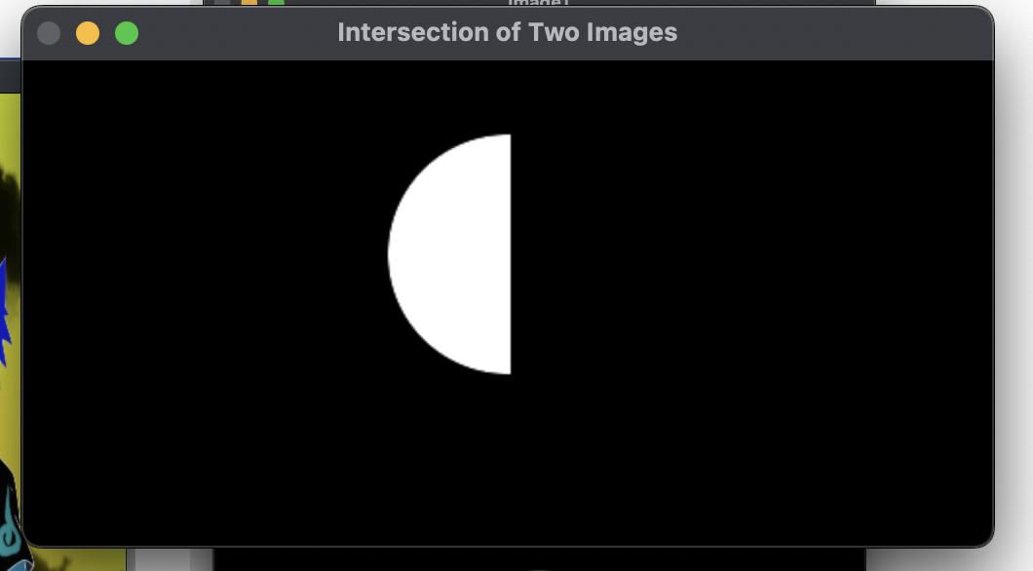
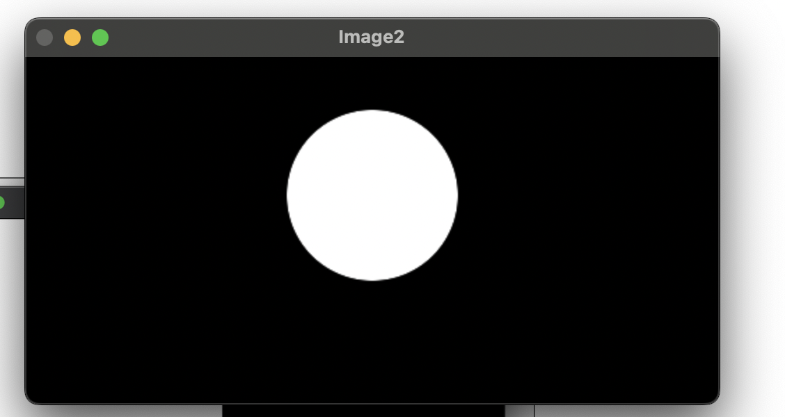
PANTONE® COLOUR OF THE YEAR 2022
OUTPUT-:

Slide 7
PANTONE® COLOUR OF THE YEAR 2022
from skimage import io
from skimage import color
import numpy as np
from numpy.fft import fft, fftfreq, ifft
from scipy import ndimage as nd
from scipy.fft import fft, ifft
from scipy import fftpack
from PIL import Image, ImageDraw
import matplotlib.pyplot as plt
import cv2
img = io.imread("butterfly.jpeg")
plt.imshow(img)
plt.show()
# fft
img_fft = fftpack.fft2(img)
# inverse of signal
img_ifft = fftpack.ifft2(img_fft).real
plt.figure(figsize=(10,10))

Slide 8
PANTONE® COLOUR OF THE YEAR 2022
plt.subplot(131)
plt.imshow(img)
plt.title("Original")
plt.subplot(132)
plt.title("Spectrum")
plt.imshow(img_fft.astype(np.uint8))
plt.subplot(133)
plt.title("Reconstructed")
plt.imshow(img_ifft.astype(np.uint8))
plt.show()
plt.figure(figsize=(8, 6), constrained_layout=False)
img_fft = np.fft.fft2(img)
img_fftshift = np.fft.fftshift(img_fft)
img_ifftshit = np.fft.ifftshift(img_fftshift)
img_ifft = np.fft.ifft2(img_ifftshit)
plt.subplot(231), plt.imshow(img, "bone"), plt.title("Original Image")
plt.subplot(232), plt.imshow(np.abs(img_ifft), "bone"), plt.title("Reversed Image")
plt.show()

Slide 9
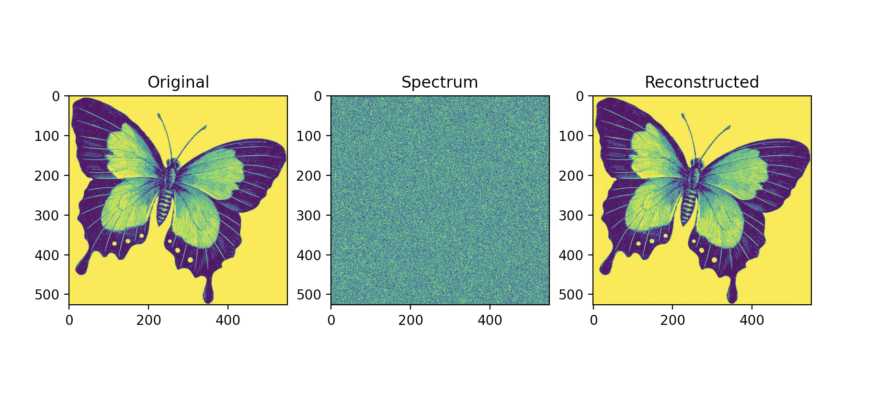
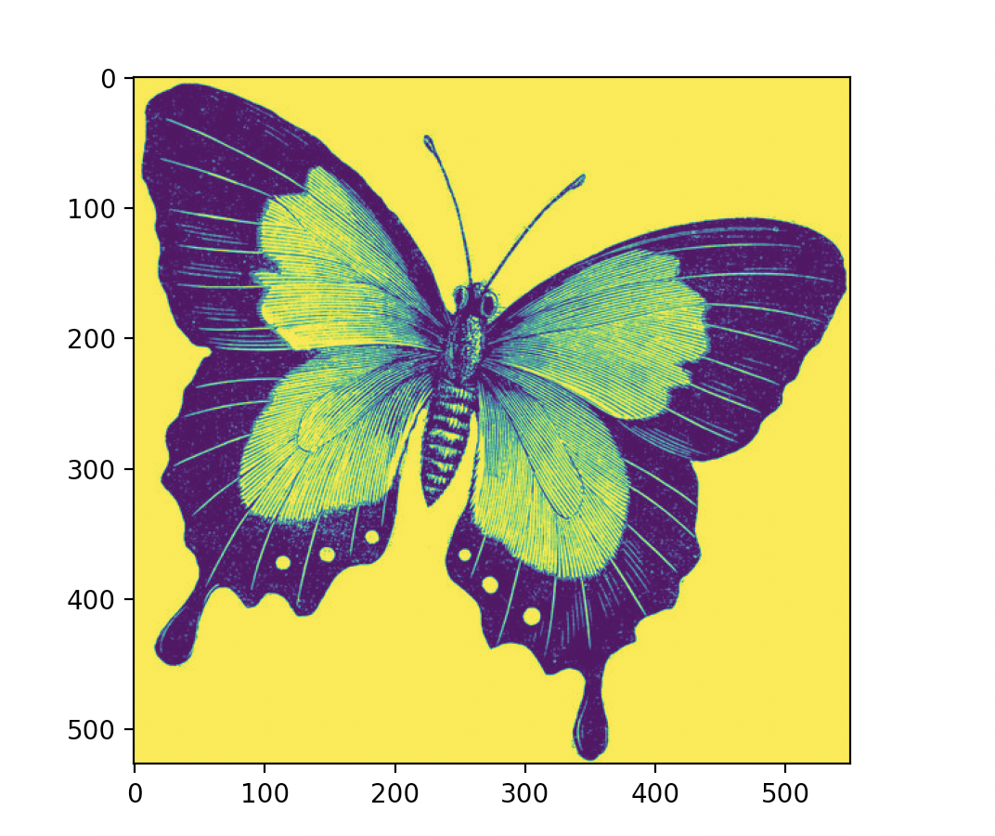
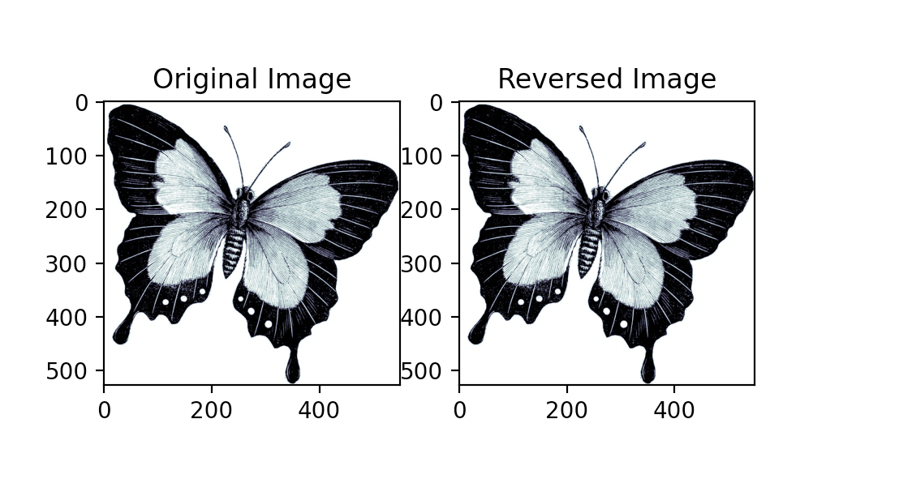
Fourier and inverse Fourier transform
OUTPUT-:

Slide 10
THANK YOU You can find the code at -: https://github.com/Baka-14/Digital_Image_processing

